Slide 1
Rice Datathon Cognite Track
Suiyuan team
Linfeng Lou, Qiurui Chang, Xijuan Liu, Ziren Wang

Slide 2
1
Objectives
2
Data Processing
CONTENTS
3
Forecasting
4
Dashboard
5
Discussion

Slide 3
OUR TASKS
Visualize the wind speed and wind direction in a time series plot. Forecast how wind speed and direction will change in the next 72 hours.
OBJECTIVES

Slide 4
OBJECTIVES
A
Data preprocessing and smoothing
Dealing with missing data;
Exploratory Data Analysis;
B
Forecasting the change of wind speed and direction
Time series analysis;
C
Building an interactive dashboard
Visualizing the wind speed and wind direction in a time series plot where upon entering the platform name;
Interactively polar plot of the daily average wind speed in the mean direction of that day;

Slide 5
Preprocessing and analysis.
DATA PROCESSING

Slide 6
DATA PROCESSING
01
Change Data Types
02
Draw Histograms and TS plots
03
Feature Selection
02
Filling Missing Values

Slide 7
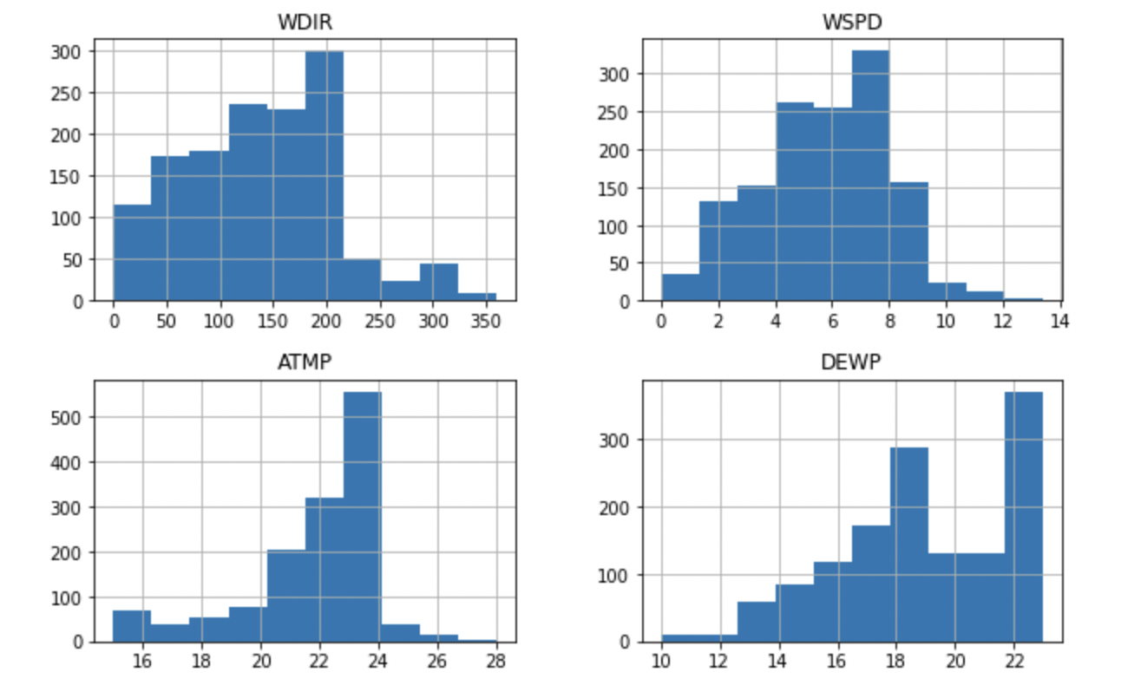
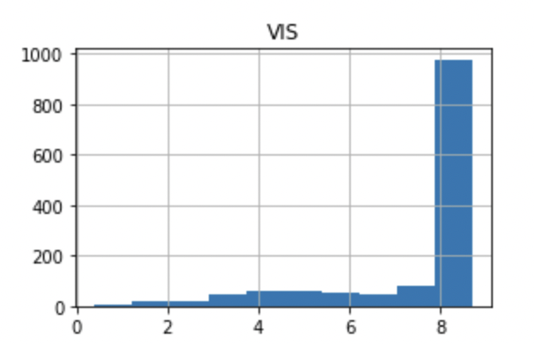
EXPLORATORY DATA ANALYSIS: DISTRIBUTION
WDIR | Wind direction
WSPD | Wind speed (m/s)
GST | Peak gust speed
ATMP | Air temperature (Celsius)
DEWP | Dewpoint temperature
VIS | Station visibility (nautical miles)

Slide 8
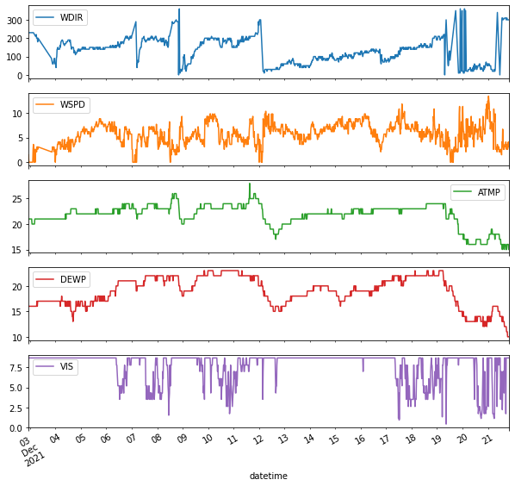
EXPLORATORY DATA ANALYSIS: TIME SERIES PLOT
WDIR | Wind direction
WSPD | Wind speed (m/s)
GST | Peak gust speed
ATMP | Air temperature (Celsius)
DEWP | Dewpoint temperature
VIS | Station visibility (nautical miles)

Slide 9
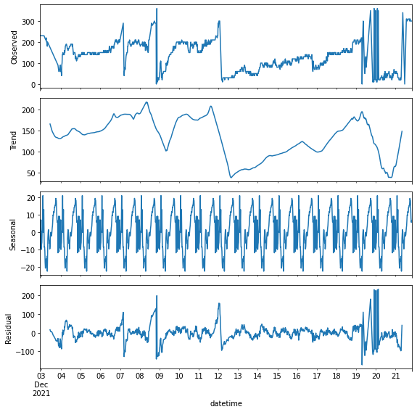
EXPLORATORY DATA ANALYSIS: TIME SERIES DECOMPOSITION For Wind Direction
Time Series Decomposition for Wind Direction

Slide 10
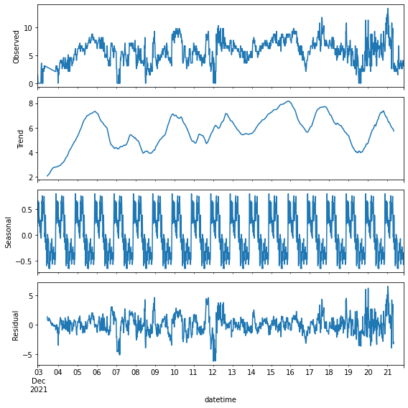
EXPLORATORY DATA ANALYSIS: TIME SERIES DECOMPOSITION for Wind Speed
Time Series Decomposition for Wind Speed

Slide 11
Our Tasks
Forecast how wind speed and direction will change in the next 72 hours
FORCASTING

Slide 12
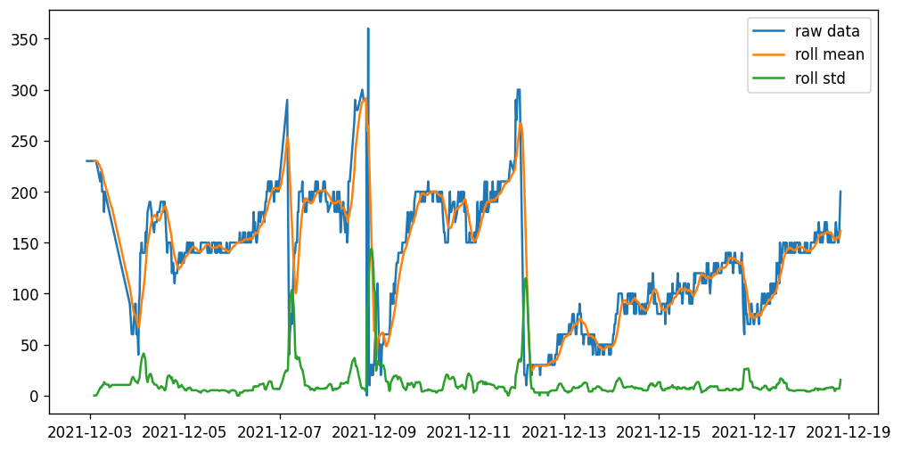
STATIONARY TEST: WIND DIRECTION
The test of data stability (10%)
Test Statistics | -4.621360
p-value | 0.000118
lags used | 5
Observation used | 1139
critical value (1%) | -3.436104
critical value (5%) | -2.864081
critical value | -2.568123
Stationary Test Results for Wind Direction

Slide 13
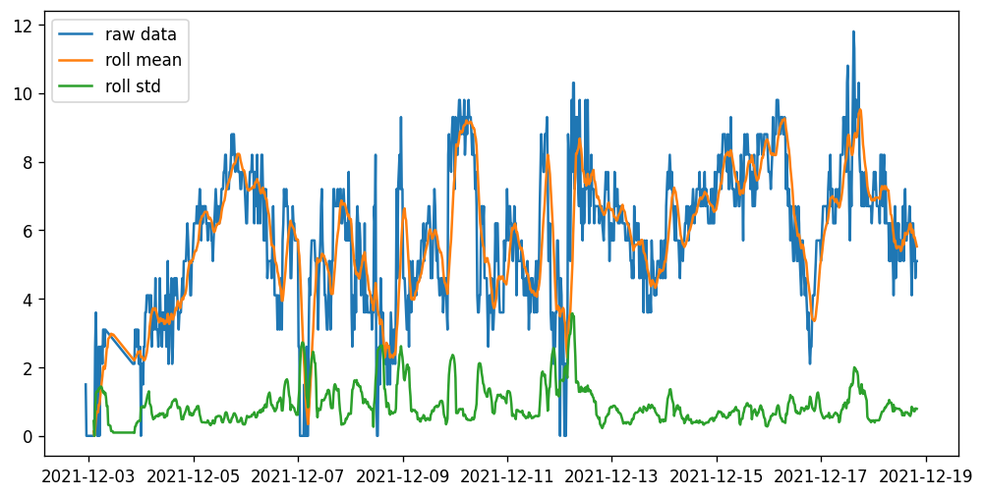
STATIONARY TEST: WIND SPEED
The test of data stability (10%)
Test Statistics | -5.655233
p-value | 9.654935e-07
lags used | 2
Observation used | 1142
critical value (1%) | -3.436089
critical value (5%) | -2.864074
critical value | -2.568119
Stationary Test Results for Wind Speed
Notes:
Our null hypotheis H0: the time series is non-stationary. As we can see from the above two tests, they all have small p-value. Therefore, we reject H0, conclude that for both WSPD and WDIR they are all stationary! This also implies that for ARIMA(p,q,d), d = 0. i.e. we don't need to difference the series

Slide 14
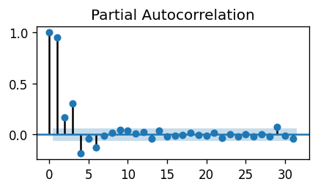
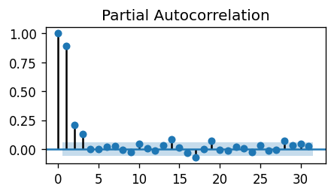
PARTIAL AUTOCORRELATION
Partial Autocorrelation for Wind Direction
Partial Autocorrelation for Wind Speed
As we can observe that the PACF lag 1 is quite significant since it is well above the significance line.

Slide 15
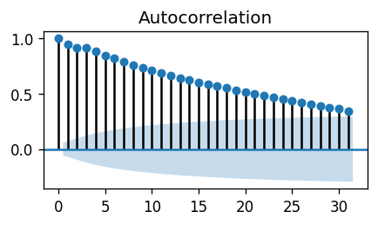
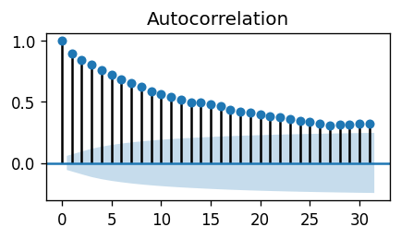
AUTOCORRELATION
Partial Autocorrelation for Wind Direction
Partial Autocorrelation for Wind Speed
As we can observe that the ACF lag 1-25 is quite significant for WDIR while ACF lag 1-20 is quite significant for WSPD .
So, we are going to set q_WDIR = 25 and q_WSPD = 20.

Slide 16
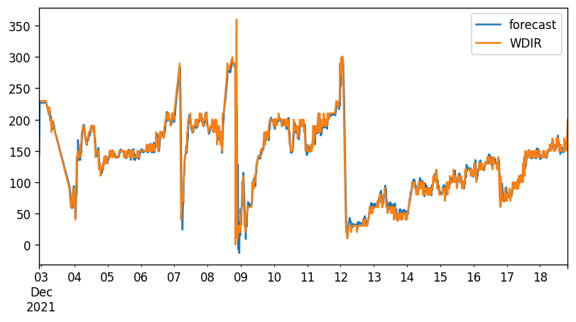
ARIMA MODEL: WIND DIRECTION

Slide 17
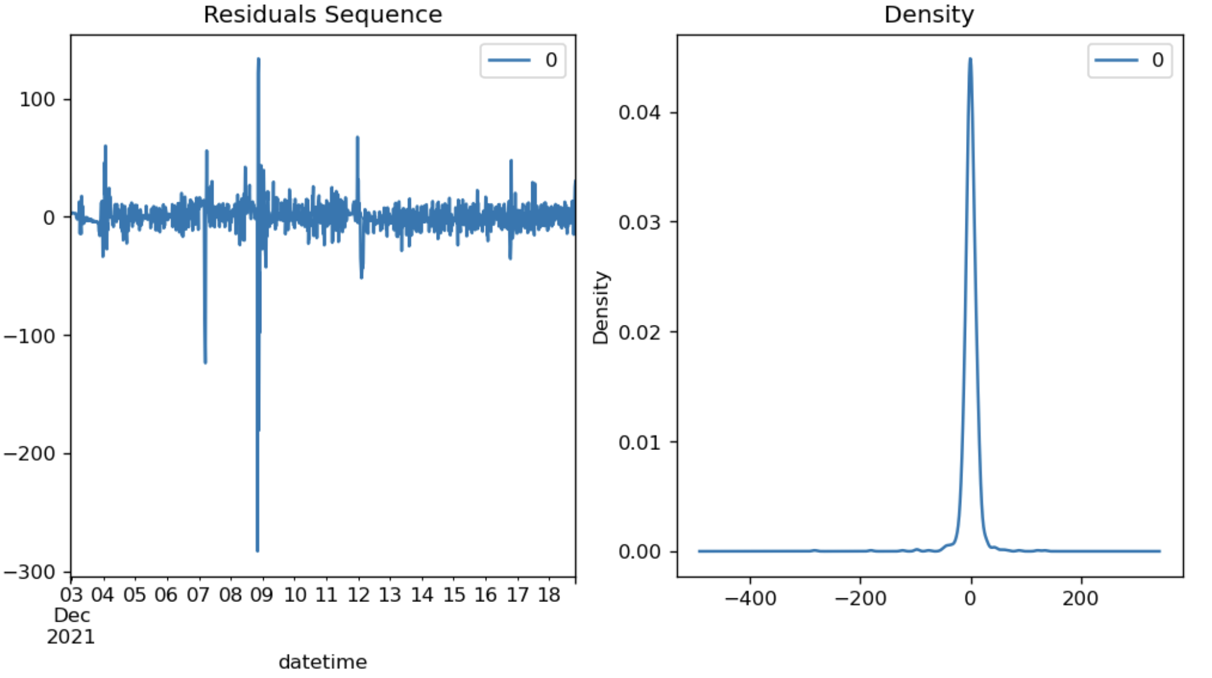
ARIMA MODEL: RESIDUAL PLOT

Slide 18
INTERACTIVE DASHBOARD
We used streamlit to create the interactive dashboard in order to visualize wind speed and direction.
DASHBOARD

Slide 19
INTERACTIVE DASHBOARD
RETRIEVE
FORECAST
SELECT
Retrieving and visualizing the wind speed and wind direction at that station for the past 45 days when entering the name of the station.
Giving the forecast of how wind speed and direction will change in the next 72 hours.
Showing a polar plot of the daily average wind speed in the mean direction of the day you select.

Slide 20

HOW TO LAUNCH
INSTALL PACKAGE
pip install streamlit
LOCATE THE FILE AND RUN IN TERMINAL
streamlit run myfile.py

Slide 21
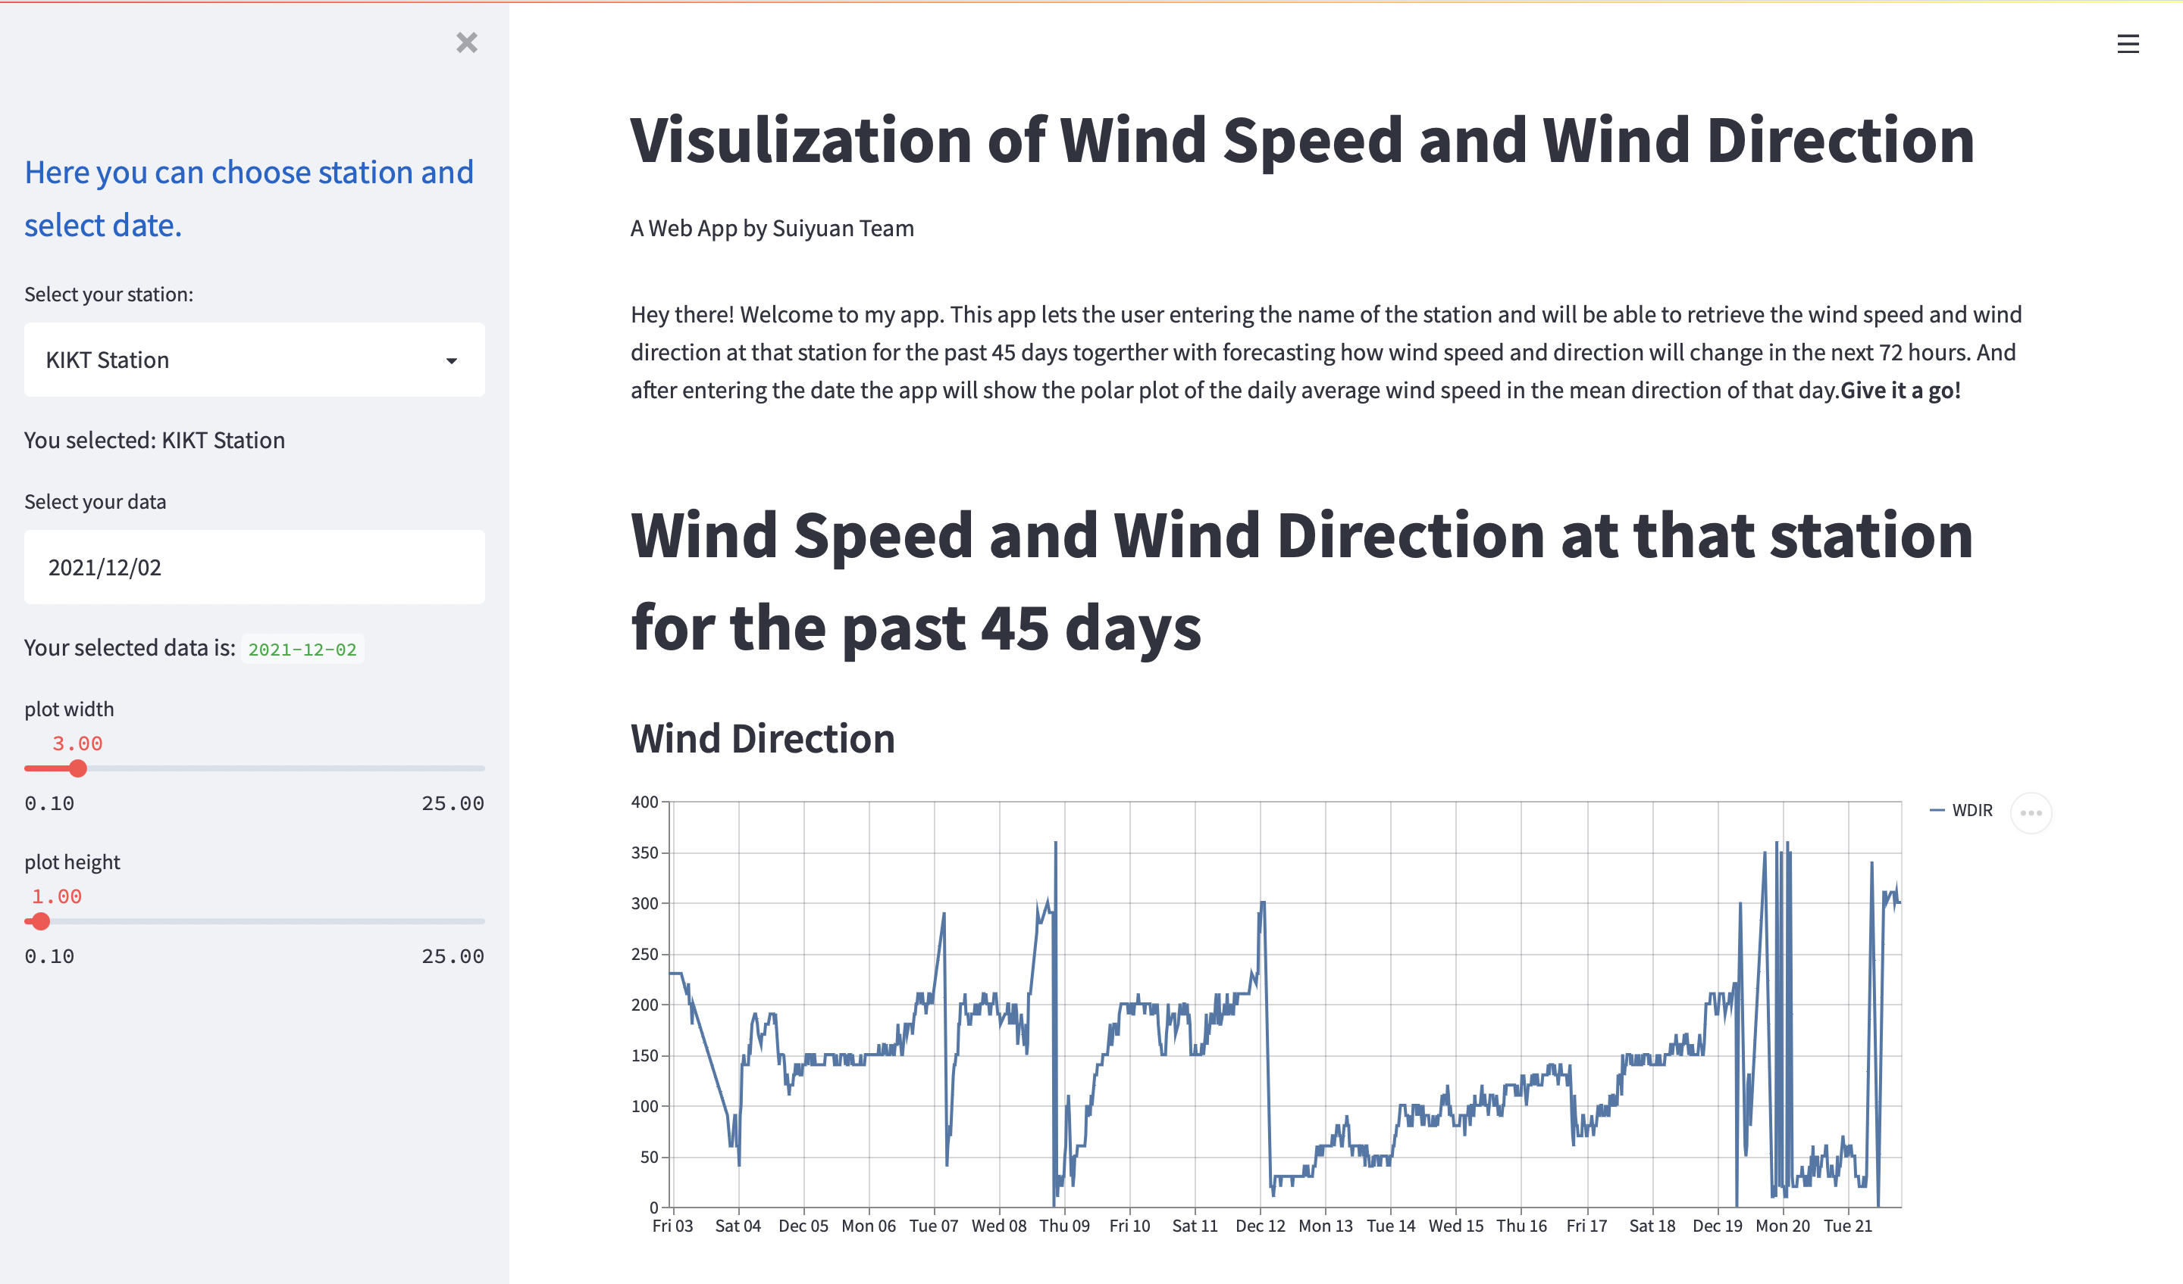

Slide 22
Deficiencies and Prospects.
FURTHER DISCUSSION

Slide 23

Temperature
We have to use temperature to predict the future wind speed and wind direction, but the future temperature have to be predicted.

Slide 24
THANKS
Suiyuan team
Linfeng Lou, Qiurui Chang, Xijuan Liu, Ziren Wang

